Slide 1
THE QUERY CREW
Vallakati srujana
vemana banni satya sri
nalagandla akhila
thirukovela sanjana

Slide 2

Problem Statement
USE CASE : RETAIL ECOMMERCE ANALYTICS USING SNOWFLAKE

Slide 3
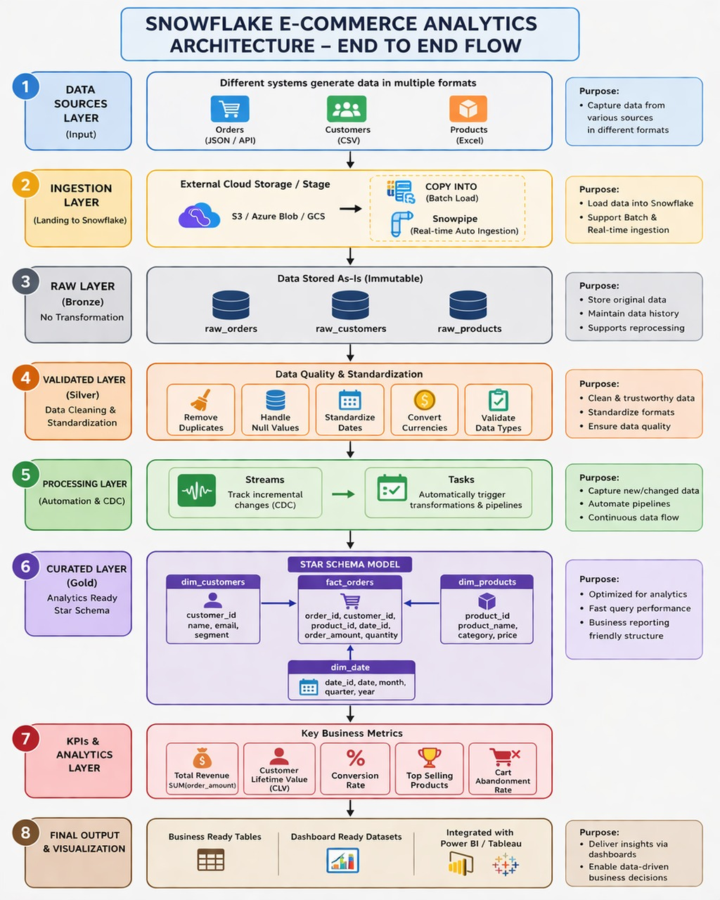
Design

Slide 4
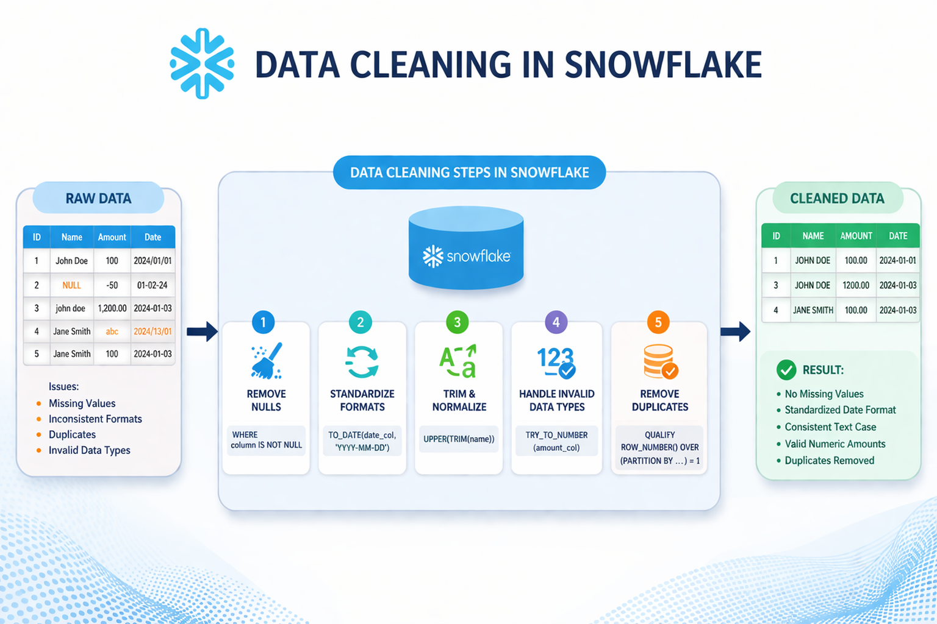

Slide 5
Implementation

Slide 6
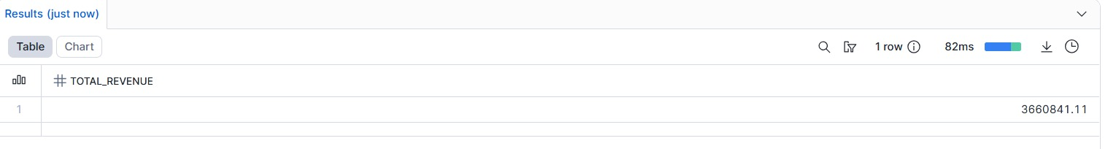
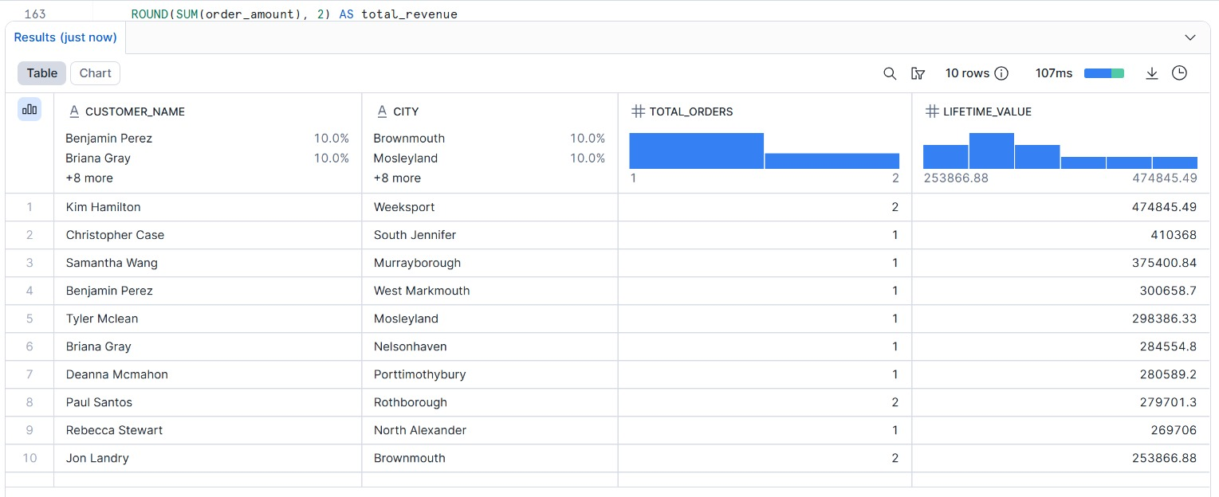
Proposed Solution Outputs

Slide 7
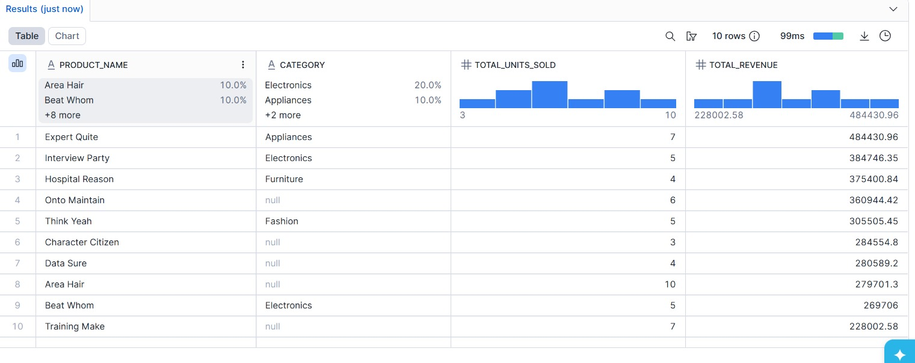
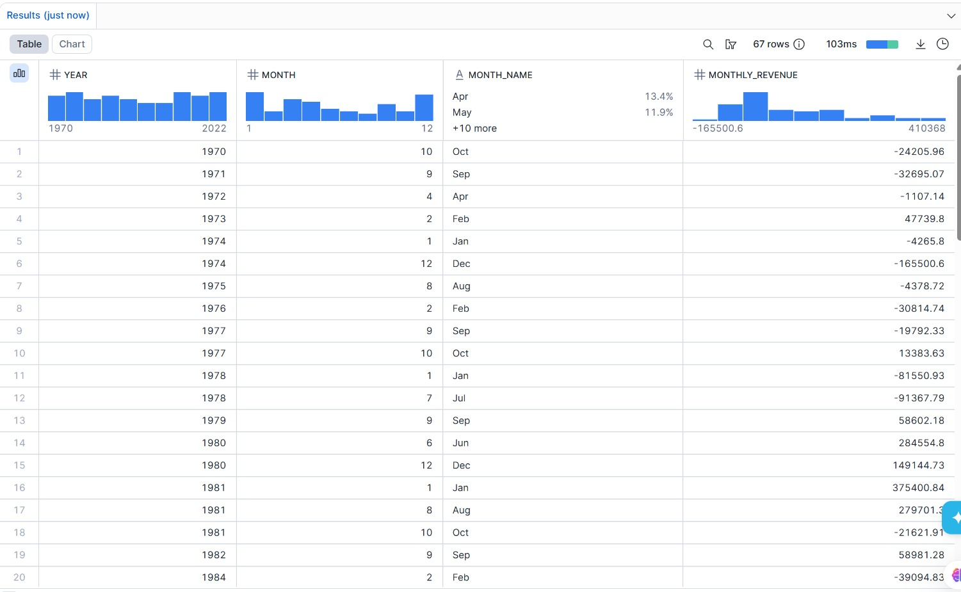

Slide 8
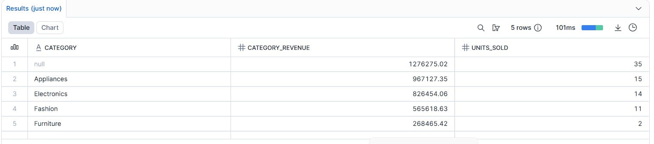

Slide 9
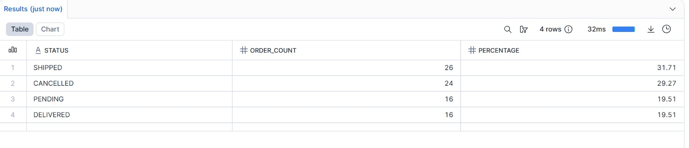
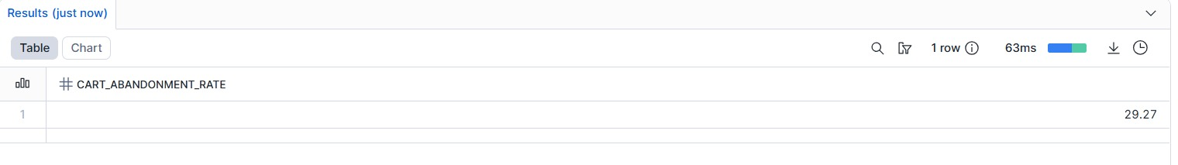

Slide 10
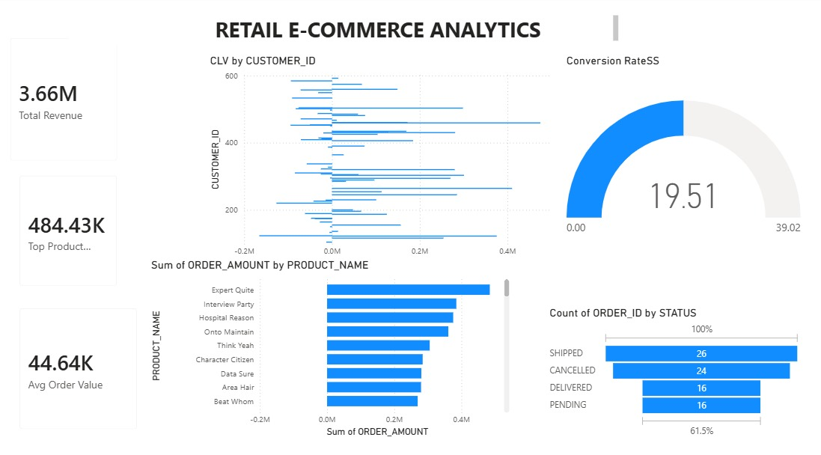
Visualization -Power BI

Slide 11


